Slide 1
Javascript Examples

Slide 2
Let's see a couple of examples
Last 2 sessions we talked about Javascript
Today:
Review Javascript basics by going through some examples
In the process we will also learn some new Javascript functionality

Slide 3
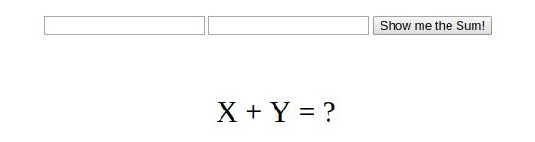
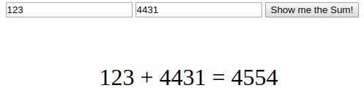
Example 1: Add two numbers
We want to create a web page that looks like this:
When the user enters numbers in text boxes and clicks the button, the sum of the two numbers will appear:

Slide 4
HTML
First let's create the HTML structure and some simple CSS
We need to create two textboxes
And a button
And a div to show the result

Slide 5
HTML
First let's create the HTML structure and some simple CSS
We need to create two textboxes
<input type="text" id="first">
<input type="text" id="second">
And a button
<button>Show me the sum!</button>
And a div to show the result
<div id="result">X + Y = ?</div>

Slide 6
CSS
Now that we have the HTML elements we needed, let's apply some css styling to:
bring everything to the center of the page and 200px from the top
show the result under the text boxes and make it bigger

Slide 7
CSS
Now that we have the HTML elements we needed, let's apply some css styling to:
bring everything to the center of the page and 200px from the top
show the result under the text boxes and make it bigger
.container {
margin: 200px auto; width: 500px;
}
Note that I use a container to put all HTML elements inside, and apply margin and width properties to the container
#result {
font-size: 2em; text-align: center; padding-top: 2em;
}

Slide 8
Javascript
Perfect! We created a webpage that looks exactly as we wanted.
But it doesn't do anything! Let's add some functionality to it by using javascript What was the main purpose of this page?

Slide 9
Javascript
Perfect! We created a webpage that looks exactly as we wanted.
But it doesn't do anything! Let's add some functionality to it by using javascript What was the main purpose of this page?
Adding two numbers
So let's write a javascript function to add two numbers
But first, we need to create a js file and include it in our HTML page

Slide 10
addTwo function
Our function is named addTwo and should accept 2 input numbers, add them up and return the result

Slide 11
addTwo function
Our function is named addTwo and should accept 2 input numbers, add them up and return the result
function addTwo(num1, num2) { let result = num1 + num2; return result;
}

Slide 12
addTwo function
Our function is named addTwo and should accept 2 input numbers, add them up and return the result
function name
function input parameters.
function keyword. must be used for all functions
function
addTwo(num1, num2) {
let result = num1 + num2;
return result;
}
function return value.

Slide 13
Calling The Function
In order to use the function we just wrote, we should call it. something like this:
myResult = addTwo(myValue1, myValue2);
Let's test if our function actually works, by using two numbers and showing the result in console:
myResult = addTwo(11, 22); console.log(myResult);

Slide 14
Calling The Function
In order to use the function we just wrote, we should call it. something like this:
myResult = addTwo(myValue1, myValue2);
Let's test if our function actually works, by using two numbers and showing the result in console:
myResult = addTwo(11, 22); console.log(myResult);
It Works!

Slide 15
Is that it?
We are pretty sure that our function works! But we only used it for two fixed values and saw the result in console.
What we wanted to do was to get the input numbers from the text boxes on our HTML page and show the result right below them, when the button is clicked.
Last time, we learned that clicking a button fires an event and we can capture that event, by creating an event Listener and attaching it to the button.
Let's do that for this example.

Slide 16
querySelector
First we need to access the button element in our javascript code.
const button = document.querySelector("button");

Slide 17
querySelector
First we need to access the button element in our javascript code.
same syntax as CSS selectors. you can refer to elements, ids or classes here.
variable name. We store the button in this variable to reuse it later
selects the first HTML element which the query applies to
const
button
= document.querySelector("button");
variable definition, we could use let or var instead. But const is preferred
The context in which the querySelector will search for the given query. Here this is the HTML file

Slide 18
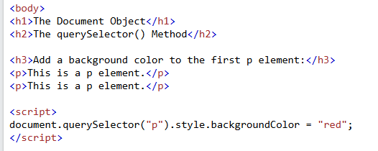
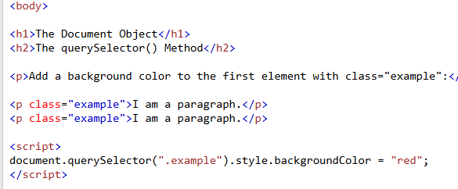
Query selector

Slide 19
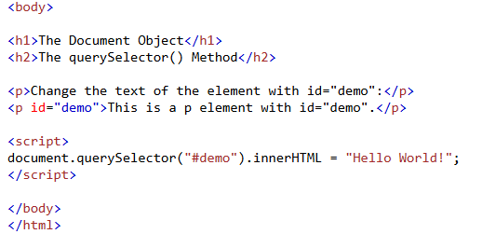
Query selector

Slide 20

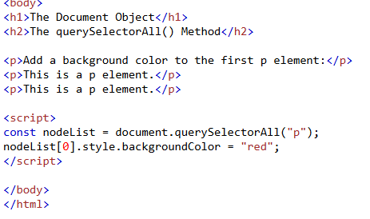
Query selector all

Slide 21
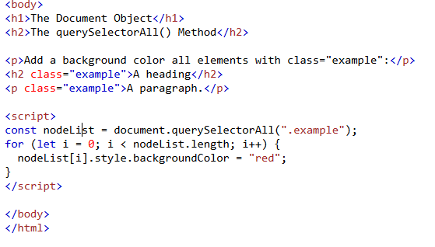
Query selector all

Slide 22
addEventListener
Then we need to attach an eventListener to our button
const button = document.querySelector("button"); button.addEventListener('click', onClick);
This is the object we want to attach the eventListener to.
This is the event we want to capture
This is the name of the function that executes each time the event is fired

Slide 23
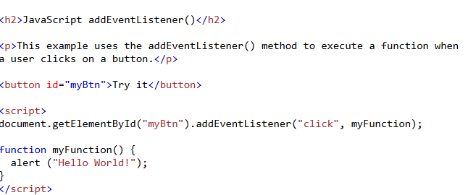

Slide 24
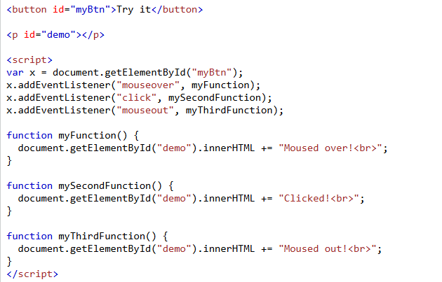

Slide 25
onClick Function
Great! So far we made sure that each time the button is clicked, onClick function will be executed. But what should onClick function actually do?
read the input values from text boxes
add them up
show the result on the web page

Slide 26
onClick Function
1. read the input values from text boxes
const num1 = document.querySelector("#first").value;
Get the value of the textbox
const num2 = document.querySelector("#second").value;

Slide 27
onClick Function
read the input values from text boxes
const num1 = document.querySelector("#first").value; const num2 = document.querySelector("#second").value;
add them up
const res = addTwo(parseInt(num1),parseInt(num2));
call the addTwo function with values from textboxes
num1 and num2 are string values. In order for our addTwo function to work, we have to convert them to numbers(integers)

Slide 28
onClick Function
read the input values from text boxes
const num1 = document.querySelector("#first").value; const num2 = document.querySelector("#second").value;
add them up
const res = addTwo(parseInt(num1),parseInt(num2));
show the result on the web page
let resultDiv = document.querySelector("#result");
what are all those + operators? what do they do?
resultDiv.textContent = num1 + " + " + num2 + " = " + res;
change the text inside the element

Slide 29
onClick Function
function onClick() {
const num1 = document.querySelector("#first").value; const num2 = document.querySelector("#second").value; const res = addTwo(parseInt(num1),parseInt(num2)); let resultDiv = document.querySelector("#result");
resultDiv.textContent = num1 + " + " + num2 + " = " + res;
}

